Slide 1
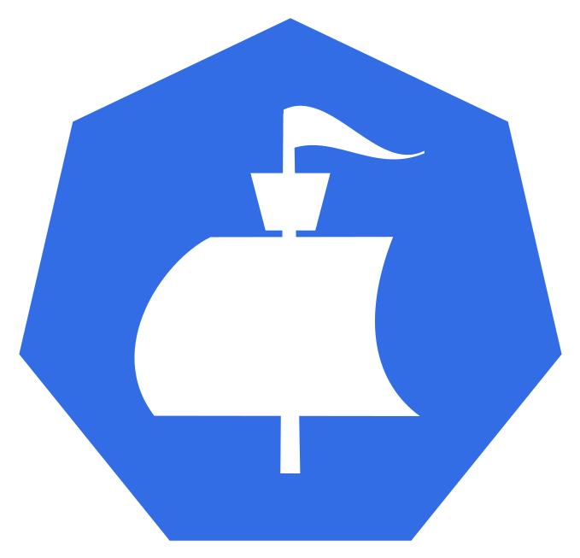

Moonraker
Visualizing Cloud Native Application Bundles
Chance Murray, Dan Kindt, Gabe Coelho, Madison Robertson & Grant Perdue
Grant
Notes:
Speakers: Grant (slides 1&2, 1.5 minutes)
--------------------------------------------
Hi, my name is Grant and our capstone project is called Moonraker.
Chance, Dan, Gabe, Madison and I, In coordination with our sponsors from Microsoft, have been working on visualizing cloud native application bundles.
We realize there may be many questions about our project, so we ask that you save those questions until after the presentation.
(next slide)

Slide 2



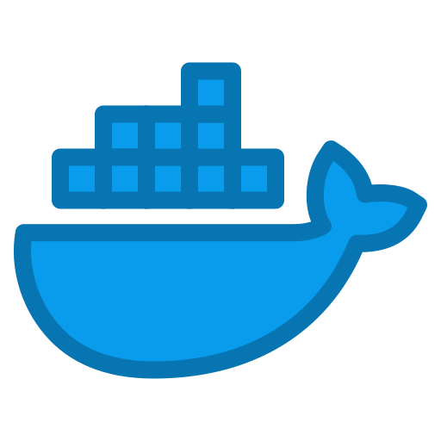
CNAB
Porter
Duffle
DockerApp
Cloud Native Application Bundles
Grant
Notes:
Speakers: Grant
--------------------------------------------
To understand what we are trying to do, it is necessary to have at least a high-level understanding of what Cloud Native Application Bundles are.
So what is a CNAB?
A CNAB is a specification for a bundle of cloud applications and services that includes scripts to install, update, and uninstall the apps all from one place.
For example, one bundle can contain scripts to install a website on Azure, a Mongo Database on Atlas, and a Queue service on AWS all with one install command.
When a CNAB is built, according to the specification, it will generate a file called a "claim", which contains information about the bundle.
There are 3 major players when it comes to CNAB management: Porter, Duffle, and Docker App. Each of these tools by default store the claims in one place, usually a hidden folder in the user's home directory.
Our capstone project attempts to aggregate the data from all of these tools into one customizable, open-source dashboard.
In order to understand the challenge we are addressing with this project, Madison prepared a short video for everyone.

Slide 3
Introduction Video
Madison
Notes:
Speakers: VIDEO
(1.5 minutes)

Slide 4
Project Objective Statement
Create a tool to help users view the data associated with their cloud-native application bundles by
April 10, 2020.
Chance
Notes:
Speakers: Chance (slides 4-7, 4 minutes)
--------------------------------------------
In order to meet the need shown in the video, Our mission for these two semesters has been to create a tool to help users view the data associated with their cloud-native application bundles by April 10, 2020.
(next slide)

Slide 5
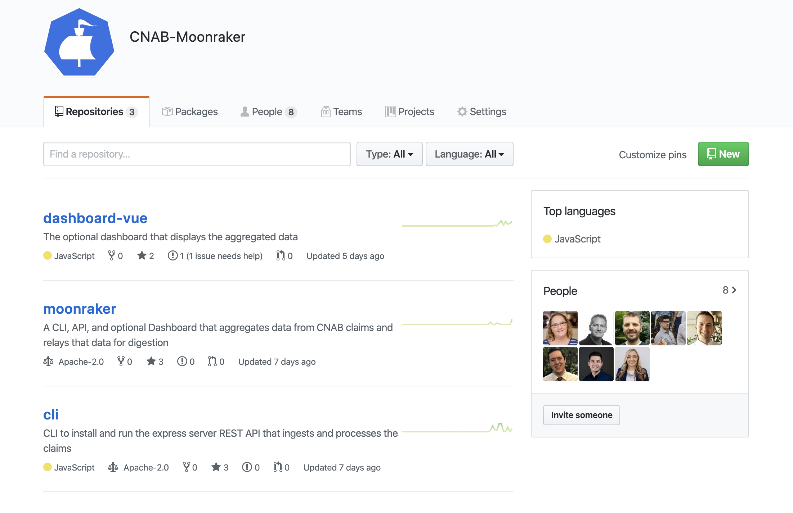

Deliverables
Fully documented API
Dashboard for viewing data
Chance
Notes:
Speakers: Chance
-----------------------------------------
We decided to build two interconnected deliverables to meet our objective: The first is a fully-documented and CLI- driven API and the second is a Web Dashboard that provides easy visualization of key CNAB data-points identified to us by our sponsor. Because we are working with tooling and specifications that live as open source projects, we built an Organization in Github to store all of our code and allow future contributions from the CNAB community. (next slide)

Slide 6
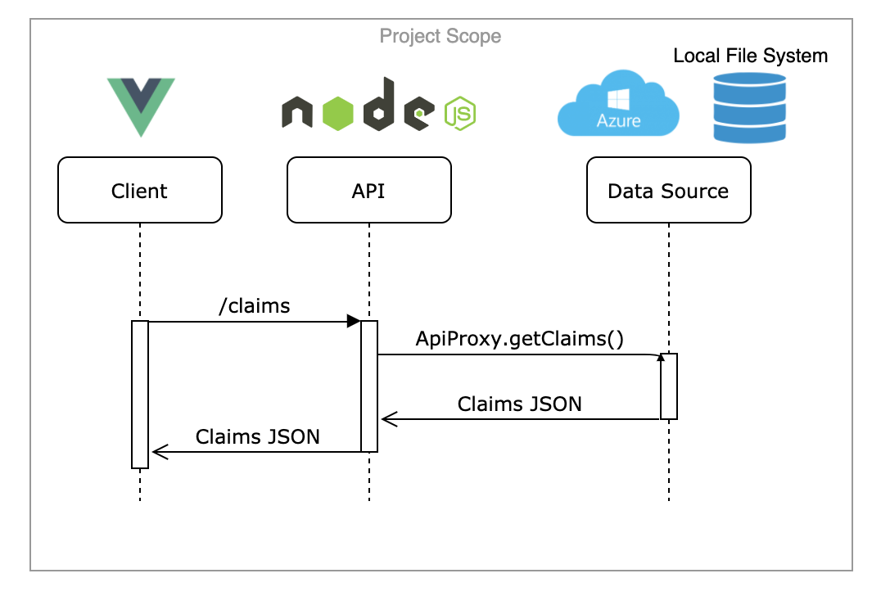
Architecture
Chance
Notes:
Speakers: Chance
-----------------------------------------
There are three major components to our application:
The DataSource, or the location of the CNAB claims, which can be local to the computer
Porter has a plugin that allows users to store claims in a azure cloud storage blob
The cli tool that serves the API was built in NodeJS and accumulates all of the claims and serves them via an HTTP endpoint as a large json Array
The tool is configurable and can read local claims or can look to see if the azure plugin has been configured for Porter and use that configuration to access the claims stored in the cloud
Our frontend dashboard is built in VueJS and is served as the index route of our API’s root endpoint. The dashboard polls and aggregates the data from the API every 5 seconds.
We chose to keep all data aggregations on the frontend in order to allow the backend to focus on serving the claims and continuing to operate fully whether or not the claims specification changes in the future.
(next slide)

Slide 7
Project Challenges and Solutions
CNAB is a fast changing open-source project
Backend implementation changed from Go to NodeJS
Porter is adding another data point to its claims
Porter’s Data Store Plugin
Gabe
Notes:
Speaker: Gabe
-----------------------------------------
Some of the challenges we faced include the fact that:
CNAB is an open-source project, and it is possible its specification will change in the future. We wanted to provide, however, a visualization for specific data points that will not change, but leave room open for new data aggregations.
We decided to change the API language FROM GoLang TO NodeJS since most of the team was already familiar with Node and it would drastically reduce development time.
In addition, the dashboard accounts for data that will be added into the Porter bundler this afternoon. The pull request including the new data point was merged a few minutes ago by the CNAB team!
Lastly, we planned on utilizing the porter’s data store plugin separately, not tied only to Porter, but interfacing with it would require a complete architectural change. Because of that, as a team we decided to write our own version of the plugin to work with claims stored in the cloud.

Slide 8
Milestones
Define project
Proof of Concept
April 4, 2020
Deliver final
API & Dashboard
October 6, 2019
December 6, 2019
November 1, 2019
March 25, 2020
Research
API & Dashboard (BETA)
Gabe
Notes:
Speaker: Gabe (3 minutes)
-----------------------------------------
This year, we had a goal to deliver the BETA version of our API and Dashboard by March 25, to get feedback from our sponsors.
After the feedback and some testing, we were able to deliver the final version of the project on April 4.
This year was full of challenges, especially the last two months working remotely, but our team was successful in delivering the project in time.

Slide 9
Stakeholders
Our sponsor, Microsoft
DevOps and infrastructure teams
Site reliability engineers
System administrators
CNAB users
Chance
Notes:
Speakers: Chance
--------------------------------------------
Ou project addresses the needs of:
Our sponsor, the Microsoft open source development team
DevOps and Infrastructure teams
Site reliability engineers
System administrators
Our ultimate goal was to have a project that can be useful to anyone using cloud native application bundles
(TRANSITION) We are now going to jump into our demos. I’ll walk through the installation and setup process, and Grant will discuss how to run Moonraker and use the Dashboard
(Play demo 1 followed by demo 2)
Keeping that in mind, we wanted our solution to be easy to use. Moonraker is available as a global npm package and can be installed with a single command
Once installed, users have access to the “moonraker” cli command, which when ran on its own shows the available commands.
Users can run “moonraker setup” to :
Create the moonraker directory with the initial configuration files
Download the dashboard repository
And install the needed dependencies to build the dashboard so that it can be served by the API’s web server
(play demo2)

Slide 10
Moonraker Demo
Grant
Notes:
Speakers: Chance 1st part, Grant video second part (5 minutes)
--------------------------------------------
Demo 1 - Install and Setup (Chance)
Demo 2 - Running Moonraker (Grant)
Notes: Cut out typing sounds, and breathing sounds lol
make it a bit quieter
maybe add some dope music?

Slide 11
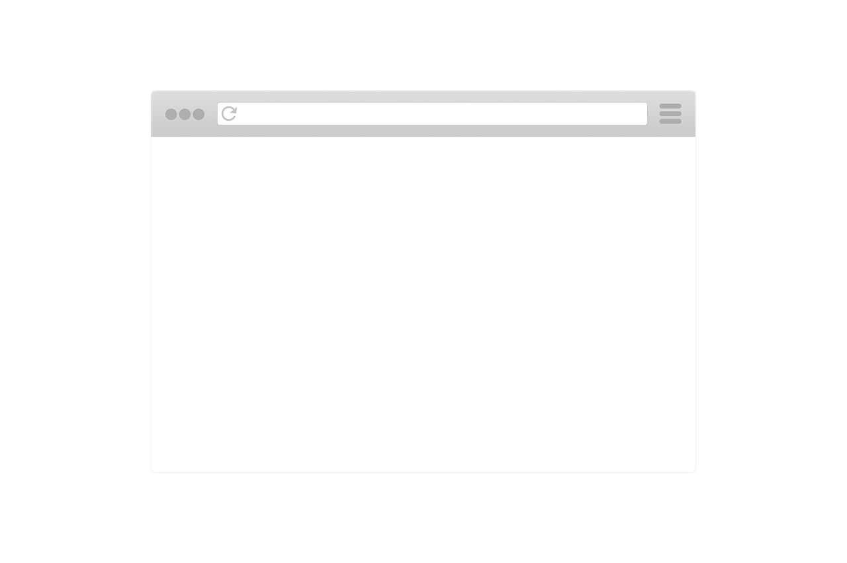
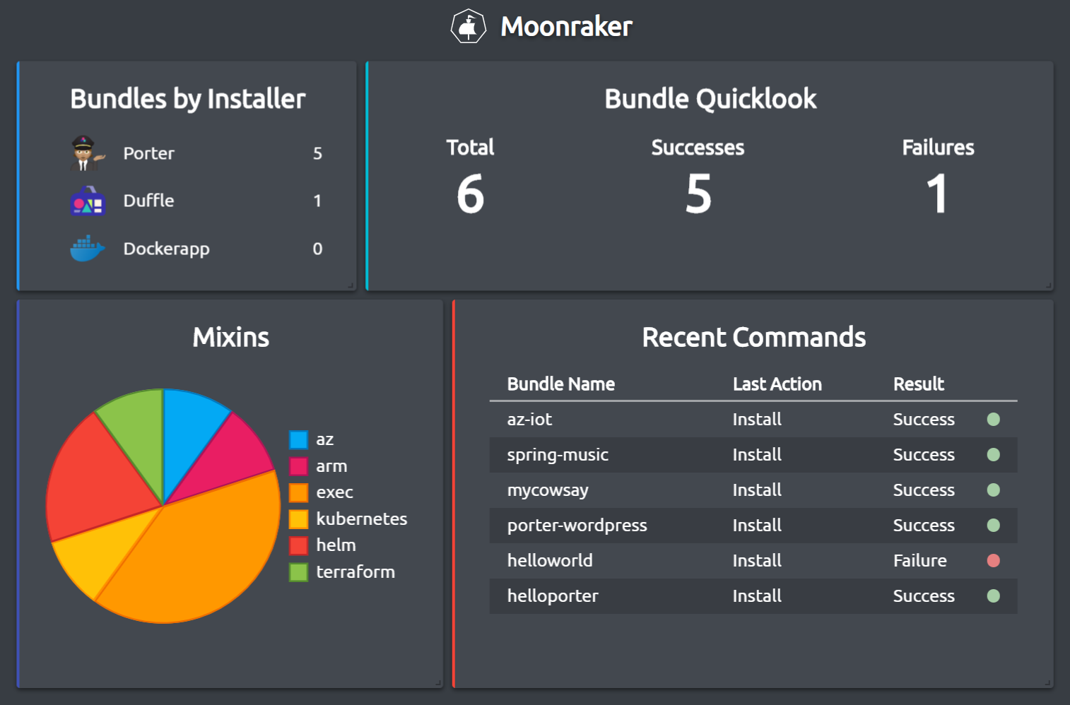
Gabe
Notes:
Speakers: Gabe
--------------------------------------------
We are incredibly happy with the result of our work, and think we have been able to solve the problem of visualizing CNABs.
Thank you for watching our presentation. We would be happy to take questions at this time.

